Slide 1
Venue match
SUBMITTED BY:
NARVASHA ADHIKARI
SAMJHANA POUDEL

Slide 2
INTRODUCTION
Our Venue Match App simplifies the venue selection process for event organizers and venue managers.
Users can find and book venues easily with personalized recommendations and detailed information.
Venue managers benefit from efficient tools for managing their venues and increasing exposure.
The app promotes transparency and collaboration through communication channels and feedback mechanisms.

Slide 3
OBJECTIVE
Simplify booking with detailed venue info and availability
Enhance user experience with easy searching and booking
Improve management with efficient tools for booking, calendars, and payments
Provide value to planners with budget, guest, and vendor management tools
Foster positive relationships with rating systems and communication channels
Provide detailed venue info for informed decisions

Slide 4
PROBLEM STATEMENT
Venue matching is complex and time-consuming.
Managing guest lists and budgets can be difficult.
Venues struggle to reach a wider audience and efficiently manage bookings.
A comprehensive and user-friendly event planner app is needed.
The app should simplify planning and enhance user experience.

Slide 5
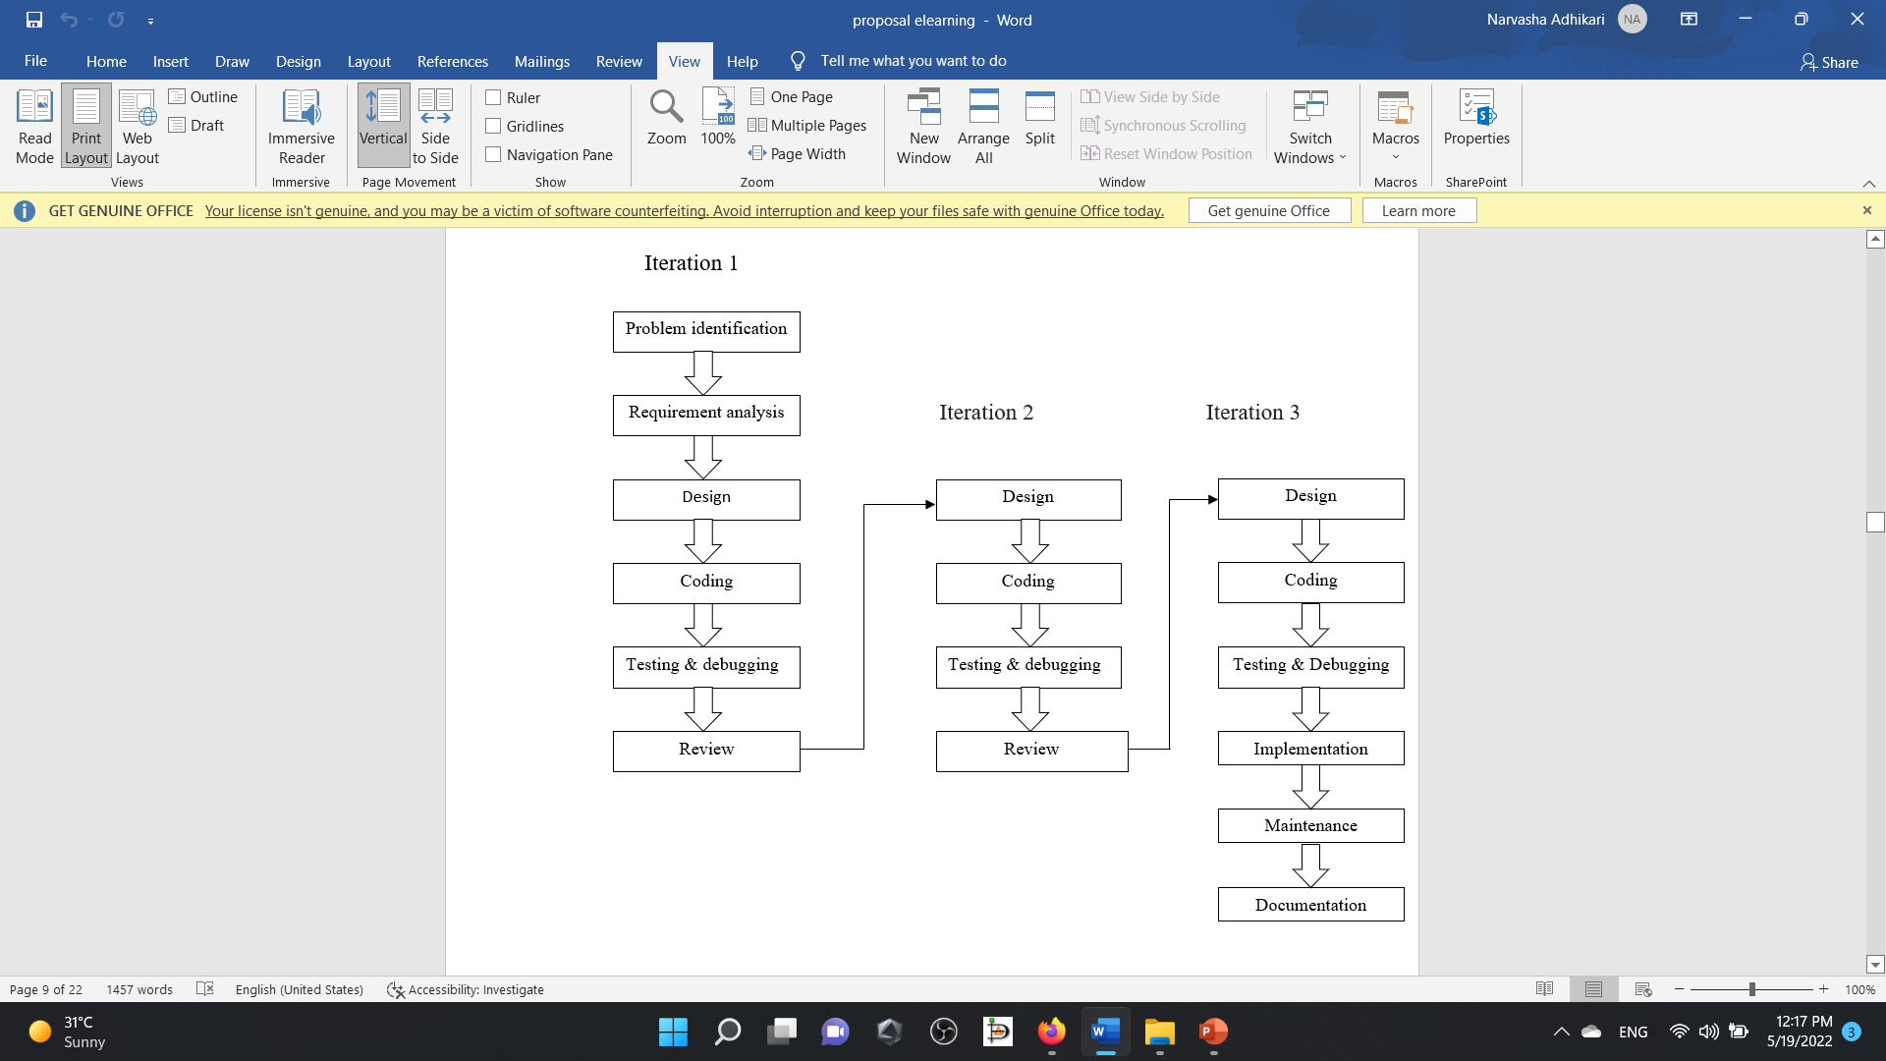
Methodology

Slide 6
DELIVERABLES
Some output we expect once the system is creates are:
User interface design.
Database of venues.
Search and filtering options.
Booking and payment system.

Slide 7


